Slide 1
CSC6103 – Virtualization Techniques
Memory Virtualization
Prof. Yeh-Ching Chung
School of Data Science
Chinese University of Hong Kong, Shenzhen

Slide 2
Outline
Basic concept of memory management
Brief introduction to ARM v7 AMSA
Memory Virtualization
  Shadow page table
  Hardware assist
  Comparison

Slide 3
Basic concept of memory management

Slide 4
Memory Management Unit
A hardware component responsible for handling accesses to memory requested by the CPU
  Address translation: virtual address to physical address (VA to PA)
  Memory protection
  Cache control
  Bus arbitration
Page tables are maintained by operating system, and MMU only references them.
TLB updates are performed automatically by page-table walking hardware

Slide 5
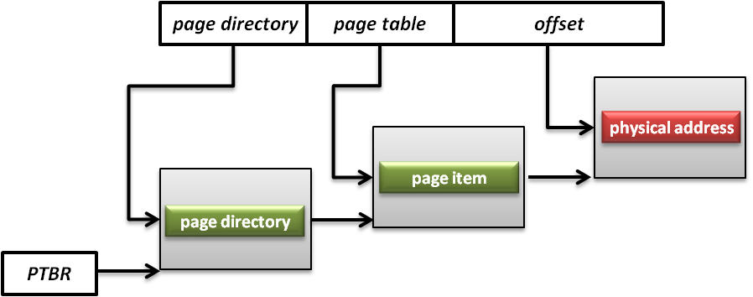
Page Tables
A page table is the data structure used by a virtual memory system to store the mapping between virtual addresses and physical addresses
Translation table base register (TTBR)
  Also called page table base register
  A register that stores the address of the base page table for MMU

Slide 6
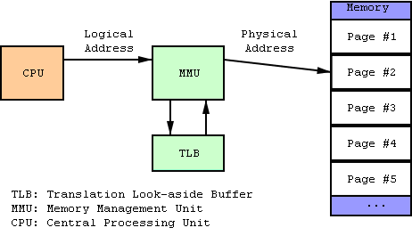
TLB
Translation look-aside buffer
  A CPU cache that memory management hardware uses to improve virtual address translation speed
  The TLB is typically implemented as content-addressable memory (CAM)
  The CAM search key is the virtual address and the search result is a physical address

Slide 7
Brief introduction to ARMv7 VMSA

Slide 8
ARMv7 VMSA
VMSA: Virtual memory system architecture
Support four mapping types
  16MB Super section
  1MB Section
  64KB Large page
  4KB Small page
Basically a 32-bit two-layer translation table
Other features (virtualization extension and 64-bit large physical address extension) would be mentioned in the future class

Slide 9
L1 Page Table
First-level table
  Translation properties for a Section and Super-section
  Translation properties and pointers to a second-level table for a Large page or a Small page.
L1 descriptor[1:0]
  0b00, invalid or fault entry
    Translation fault
  0b01, page table
    Address of 2nd level translation table
  0b10, section of super-section
  0b11, special usage with PXN attribute

Slide 10
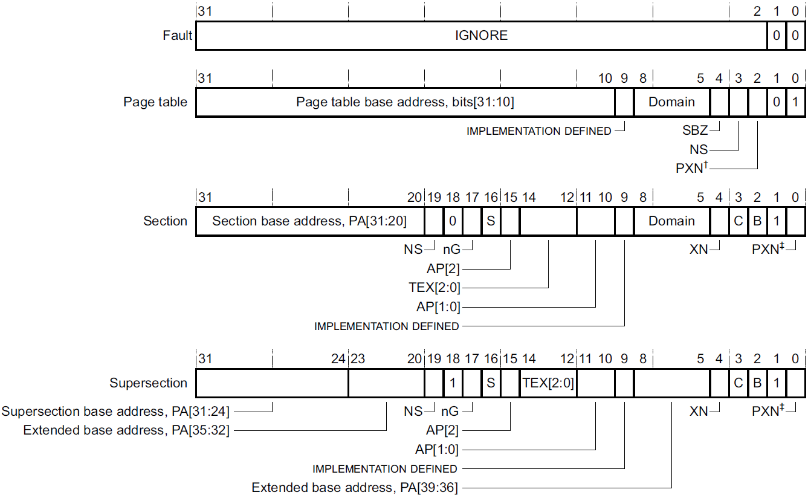
1st Page Table Descriptor

Slide 11
L2 Page Table
Second-level tables
  The base address and translation properties for a Small page or a Large page.
  That is, page tables
  1KB
L2 descriptor[1:0]
  0b00, invalid or fault entry
    Translation fault
  0b01, large page
  0b1x, small page

Slide 12
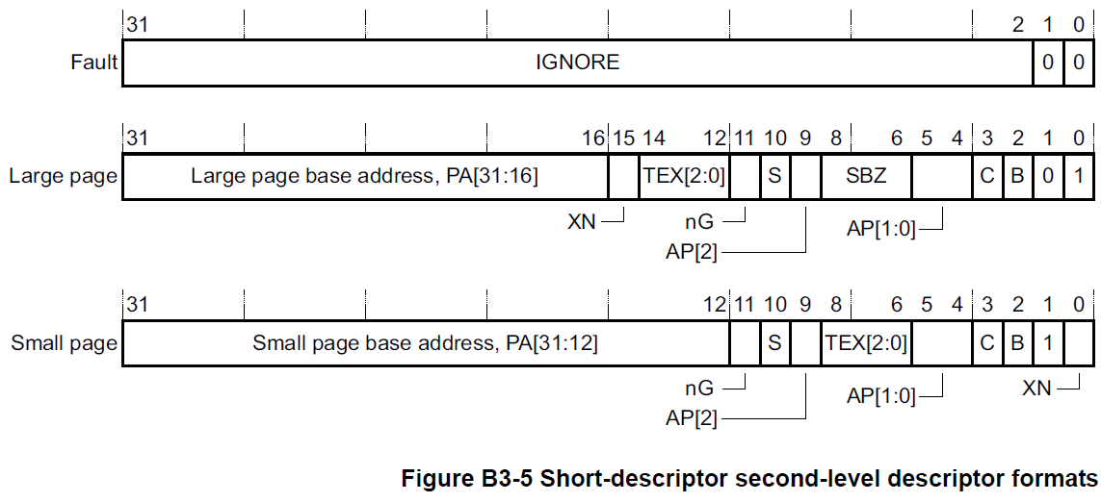
2nd Page Table Descriptor

Slide 13
Memory Virtualization

Slide 14
Memory Management on a VM
Traditionally, OS fully controls all physical memory space and provides a continuous addressing space to each process
Guest OS is just one of user space processes of host OS
If guest OS is allowed to access the physical memory arbitrarily, then what happens?
In system virtualization, VMM should make all virtual machines share the physical memory space

Slide 15
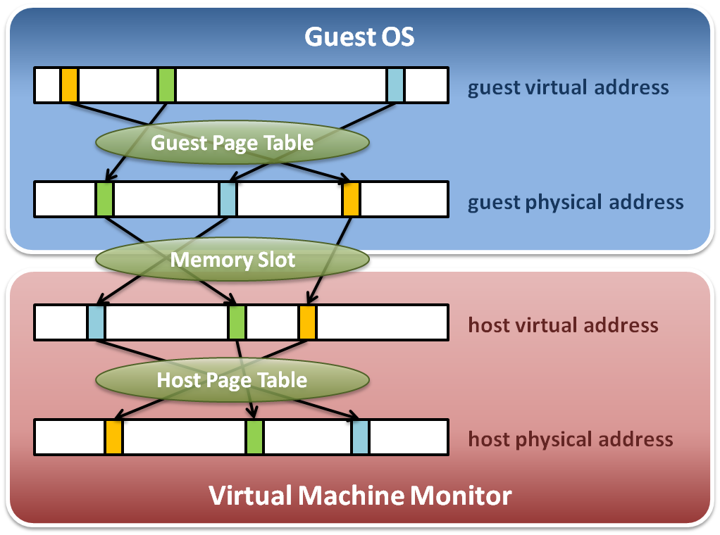
Memory Virtualization (1)
Memory virtualization architecture

Slide 16
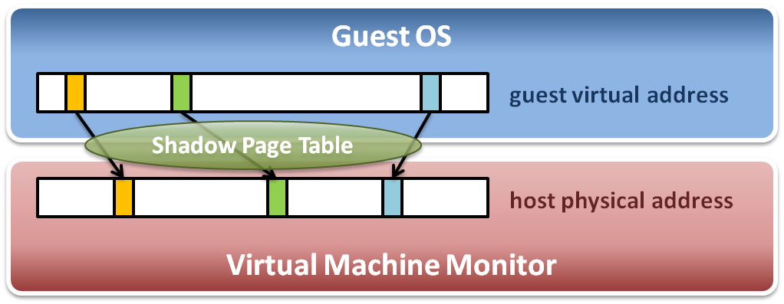
Memory Virtualization (2)
The performance drop of memory access is usually unbearable. VMM needs further optimization.
VMM maintains shadow page tables
  Direct virtual-to-physical address mapping
  Use hardware TLB for address translation

Slide 17
Goals of Memory Virtualization
Address Translation
  Control table-walking hardware that accesses translation tables in main memory
Memory Protection
  Define access permission which uses the Access Control Hardware.
Access Attribute
  Define attribute and type of memory region to direct how memory operation to be handled.
How to implement?
  Software solution: shadow page table
  Hardware solution
    NPT on SVM from AMD
    EPT on VMX from Intel
    ARM v7 VMSA (Virtual Memory System Architecture) with virtualization extension

Slide 18
Shadow page table
Memory Virtualization

Slide 19
Shadow Page Table (1)
Map guest virtual address to host physical address
  Shadow page table
    Guest OS will maintain its own virtual memory page table in the guest physical memory frames.
    For each guest physical memory frame, VMM should map it to host physical memory frame.
    Shadow page table maintains the mapping from guest virtual address to host physical address.
  Page table protection
    VMM will apply write protection to all the physical frames of guest page tables, which lead the guest page table write exception and trap to VMM.

Slide 20
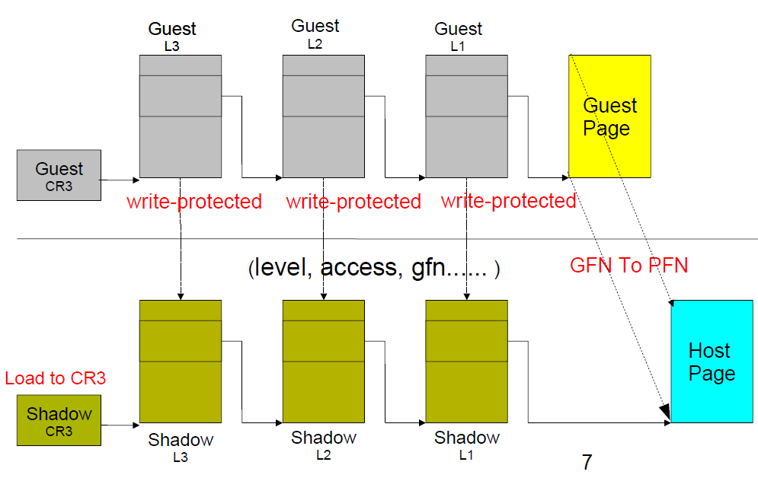
Shadow Page Table (2)

Slide 21
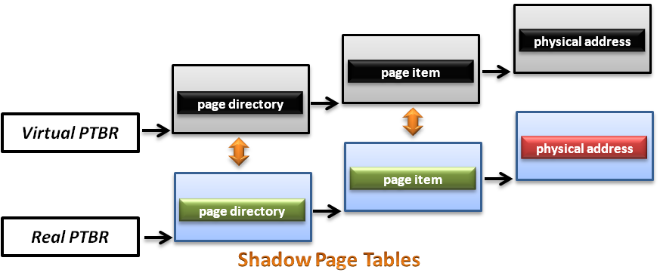
Shadow Page Table (3)
How does this technique work
  VMM should make MMU virtualized
    VMM manages the real PTBR and a virtual PTBR for each VM
    When a guest OS is activated, the real PTBR points to the corresponding shadow page table of the guest OS
    When the guest OS attempts to modify the PTBR, it will be intercepted by VMM for further emulation

Slide 22
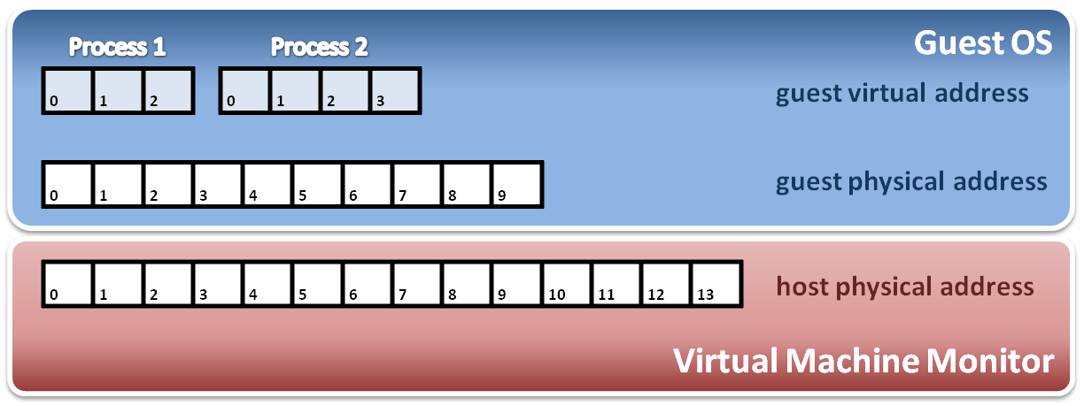
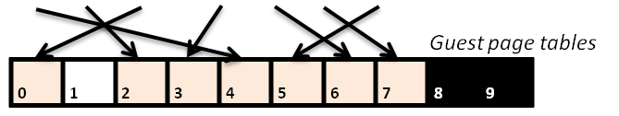
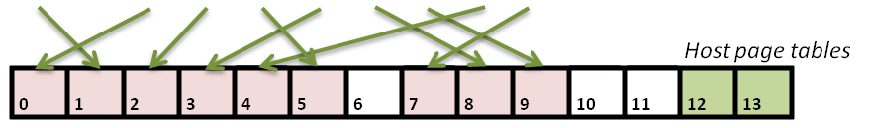
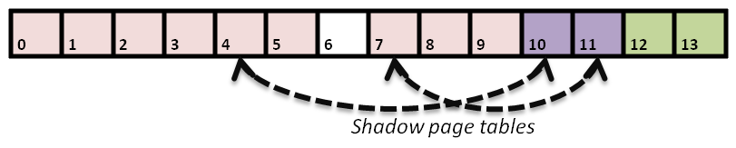
Shadow Page Table (4)
Construct shadow page table
  Guest OS will maintain its own page table for each process.
  VMM maps each guest physical page to host physical page.
  Create shadow page tables for each guest page table.
  VMM should protect host frame which contains guest page table. (that means to write protect the guest page tables in host memory)
Write protection

Slide 23
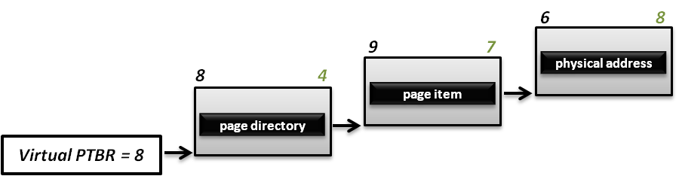
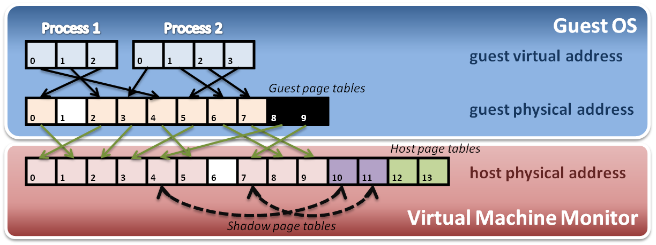
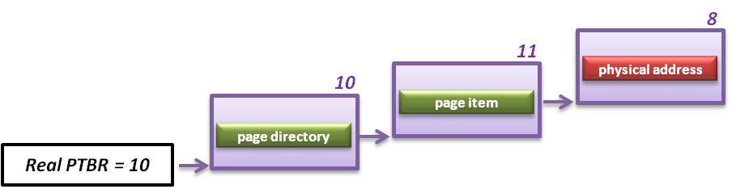
Shadow Page Table
Implement with PTBR
  For example, process 2 in guest OS wants to access its memory whose page number is 1

Slide 24
SPT Maintenance
If guest OS modify one of its page tables, then the corresponding entry of SPT must be updated.
  We call it “shadow” because SPT is just like the shadow of page tables of guest OS.
How to identify this kind of modification?
  Guest OS could read/write a physical frame with the help of SPT
  Mark those physical frames used as guest page tables read-only, so that when a guest OS tries to modify its guest page table, an exception would be triggered.
  Then VMM checks the modification and updates the corresponding entry on SPT

Slide 25
Shadow Page Table
Context switch
New process
Access
Guest OS
Process 1
Page Table
Process 2
Page Table
Process 3
Page Table
Virtual PTPR
Real PTPR
VMM
Page fault !
Shadow 1
Page Table
Shadow 1
Page Table
Shadow 3
Page Table
Create new shadow page table mapping to new process
Load !
Corresponding mapping table
Switch the pointer to new location

Slide 26
Big Overhead
A page fault caused by guest OS would launch the walking process that costs a lot of overhead.
  Several steps to get a new entry on shadow page table
    Walk page tables on guest OS
    Check the permission on guest
    Offset shift: GPA to HVA
    Walk page tables on VMM
    Check the permission on VMM
    New entry established!
    Invalidate the TLB entry
  Each new process on guest OS would consume two pages. One is the page table on guest OS, and the other is the corresponding shadow page table.

Slide 27
Page Walking Process on ARM
PABT / DABT
Trap
Real MMU Behavior
Shadow Table Behavior
1
2
3
Initial
Synchronization
Guest
Page Table
Walker
Guest
Permission
Checker
MMIO
Access
Checker
Shadow Page Table
Mapping
Shadow Page Table
Update
True permission fault
Hidden translation fault
True translation fault
MMIO emulation

Slide 28
Step 1
While a page fault is occurred, Guest Page Table Walker will walk through guest page table to check if the fault is from guest
PABT / DABT
Trap
1
Guest
Page Table
Walker
Guest
Permission
Checker
MMIO
Access
Checker
Shadow Page Table
Mapping
Shadow Page Table
Update
True permission fault
Hidden translation fault
True translation fault
MMIO emulation

Slide 29
Step 2
Check if guest access permission is not allowed
PABT / DABT
Trap
2
Guest
Page Table
Walker
Guest
Permission
Checker
MMIO
Access
Checker
Shadow Page Table
Mapping
Shadow Page Table
Update
True permission fault
Hidden translation fault
True translation fault
MMIO emulation

Slide 30
Step 3
Check if the guest physical memory address used is located in the range of MMIO address
PABT / DABT
Trap
3
Guest
Page Table
Walker
Guest
Permission
Checker
MMIO
Access
Checker
Shadow Page Table
Mapping
Shadow Page Table
Update
True permission fault
Hidden translation fault
True translation fault
MMIO emulation

Slide 31
Steps 4 & 5
Used to build up shadow page tables and maintain their consistency between guest and shadow ones
PABT / DABT
Trap
4
5
Guest
Page Table
Walker
Guest
Permission
Checker
MMIO
Access
Checker
Shadow Page Table
Mapping
Shadow Page Table
Update
True permission fault
Hidden translation fault
True translation fault
MMIO emulation

Slide 32
SPT Optimization (1)
Para-virtualization
  Reduce VM exits
  Guest OS would send a hyper call to VMM when guest OS sets the page table entries.
  This method will eliminate from using write-protection for synchronization
No trap for non-present PTEs
  Reduce VM exits
  If the page-fault is caused by PTE not present, it is not intercepted by the host
  Only works on VMX

Slide 33
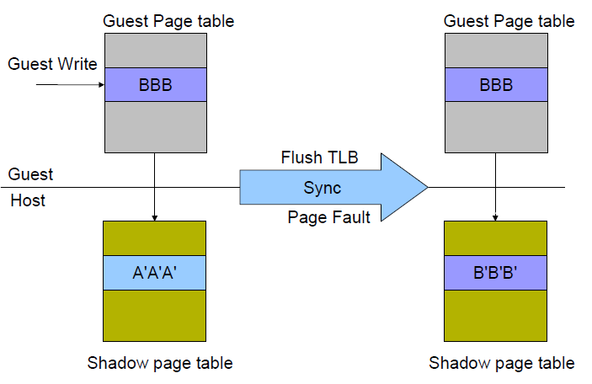
SPT Optimization (2)
Un-synchronize shadow page table pages
  Reduce VM exits
  Allow the guest page table to be writable if and only if the page is the last level page-structure (level 1)
  Based on TLB rules
    We need to flush TLB to ensure the translation use the modified page structures, then we can Intercept the TLB flush operations and sync shadow pages
    Sometimes, TLB need not be flushed, then it can be synced through page fault

Slide 34
SPT Optimization (3)
KSM (kernel shared memory)
Kernel space
Kernel space
User space
User space
Guest Process 1
Guest Process 2
Shadow table
Kernel space
Shadow table
The shadow tables of kernel space
are shared by all guest processes
User space
Shadow table

Slide 35
Other Issues
Page fault and page protection issue
  When a physical page fault occurs, VMM needs to decide whether this exception should be injected to guest OS or not
    If the page entry in a guest page table is still valid, VMM prepares for the corresponding page and does not inject any exception to guest OS.
    If the page entry in a guest page table is invalid, then VMM directly injects the virtual page fault to guest OS.

Slide 36
Hardware assist
Memory Virtualization

Slide 37
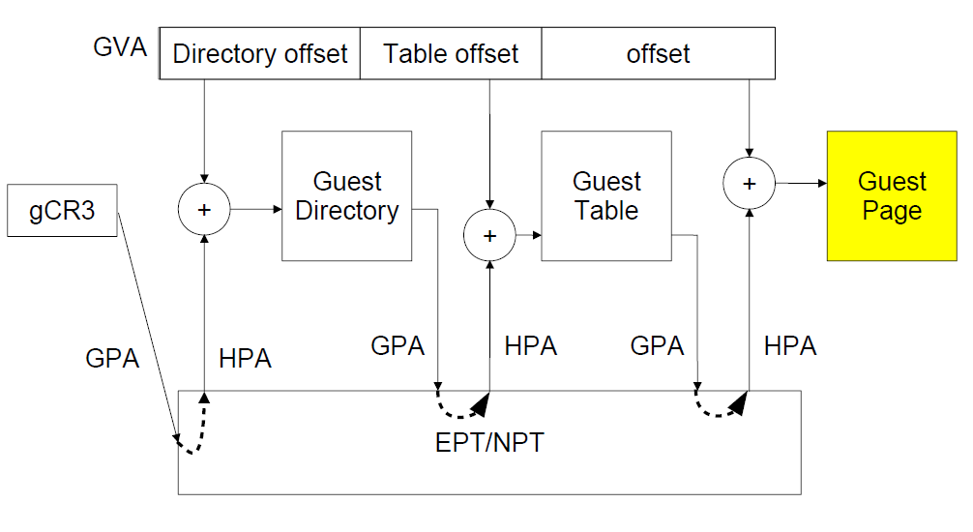
Hardware Assistance - Overview

Slide 38
Hardware Solution
Difficulties of shadow page table technique :
  Shadow page table implementation is extremely complex.
  Page fault mechanism and synchronization issues are critical.
  Host memory space overhead is considerable.
But why we need this technique to virtualize MMU
  MMU do not first implemented for virtualization.
  MMU is knowing nothing about two level page address translation.
Now, let us consider hardware solution.

Slide 39
Extended Page Table (1)
Concept of Extended Page Table (EPT)
  Instead of walking along with only one page table hierarchy, EPT technique implement one more page table hierarchy.
    One page table is maintained by guest OS, which is used to generate guest physical address.
    The other page table is maintained by VMM, which is used to map guest physical address to host physical address.
  For each memory access operation, EPT MMU directly gets the guest physical address from guest page table, and then gets the host physical address by the VMM mapping table automatically.

Slide 40
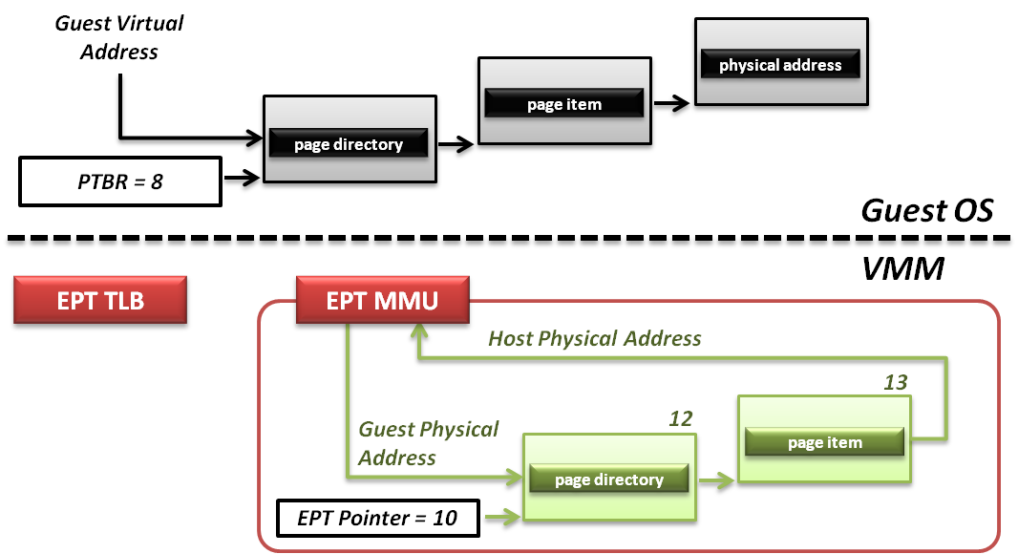
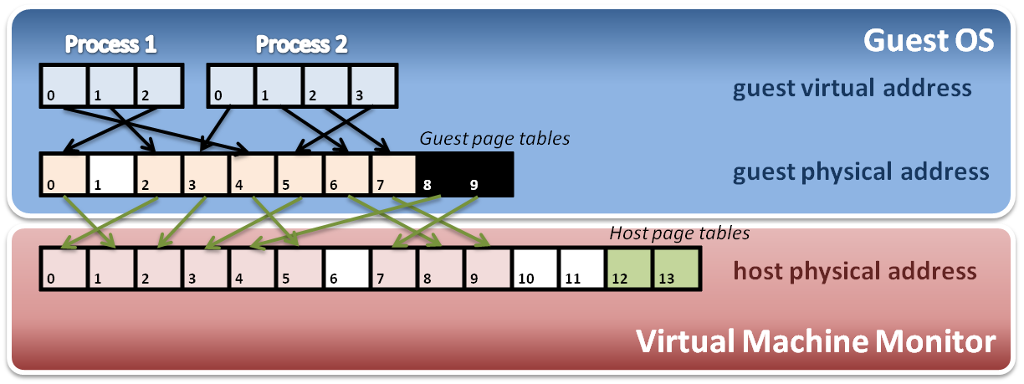
Extended Page Table (2)
Memory operation
6
8
9
7
8
4
Data

Slide 41
Comparison
Memory Virtualization

Slide 42
Questions
Computer architecture with virtualization extension is a trend.
Hardware-assisted techniques replace many software methods of virtualization.
However, is hardware-assisted implementation a definite winner?

Slide 43
Comparisons
Hardware-assisted
Software solution
Walk any requested address
  Appropriate to programs that have a large amount of page table miss when executing
  Less chance to exit VM (less context switch)
Two-layer EPT
  Means each access needs to walk two tables
Easier to develop
  Many particular registers
  Hardware helps guest OS to notify the VMM
Only walk when SPT entry miss
  Appropriate to programs that would access only some addresses frequently
  Every access might be intercepted by VMM (many traps)
One reference
  Fast and convenient when page hit
Hard to develop
  Two-layer structure
  Complicated reverse map
  Permission emulation

Slide 44
Combination
Is hardware-assisted implementation a definite winner?
  No
  How about combining these two methods?
Selective memory virtualization
  The VMM can dynamically choose the memory management mechanism depending on the executing status.
  Challenge
    Hard to figure out the standard that we judge a program performs too many page table misses
    An accurate algorithm to sample behaviors of a program is necessary
  Group from Peking University completed a selective solution on VEE 2011
    Gain just a little bit performance improvement
    For now, it’s not worth to do so.

Slide 45
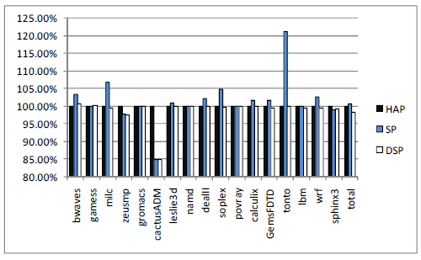
Selective Memory Virtualization
Experiment data
  The bar shows the normalized execution time
  The lower, the better.
  HAP: hardware-assisted page table
  SP: shadow page table
  DSP: dynamic selective page table
  Take hardware extension as 100%
We can see that…
  Generally HAP is faster than SPT, but not always.
  The performance of DSP is best , but only tiny disparities. (about 2%)

Slide 46
Memory Virtualization Summary
Software implementation
  Memory architecture
    MMU (memory management unit)
    TLB (translation look-aside buffer)
  Shadow page table
    MMU virtualization by virtual PTBR
    Shadow page table construction
    Page fault and page table protection
Hardware assistance
  Extended page table
    Hardware walk guest and host page table simultaneously

